Slide 1

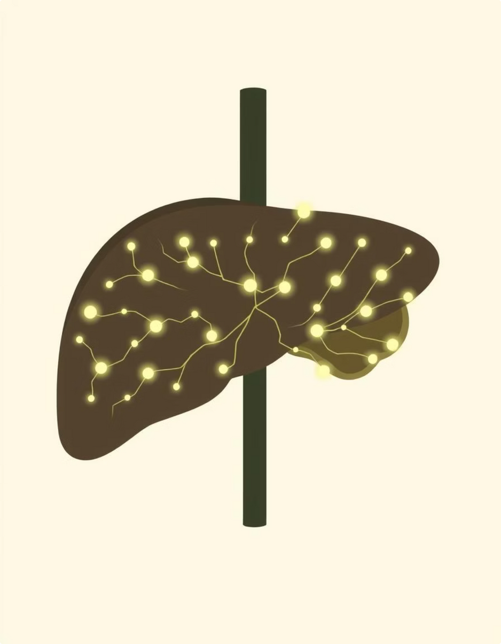
Liver Disease Prediction
A Classification Project
Group No - 05
Janhavi Dusad
Kallem Sai Rohan
ALAM NAWAZ SHA
Chintanippula Teja
Kiran Godbole

Slide 2
Business Objective
Categorical Prediction
Disease Categories
Classification Task
Predicting liver disease status.
No disease, suspect, hepatitis C, fibrosis, cirrhosis.
This is a classification project.

Slide 3
Introduction
This project is all about:
  Using information to predict liver disease.
  Developing a way to help doctors identify liver conditions early.
  Identifying conditions such as no disease, suspect cases, hepatitis C, fibrosis, or cirrhosis.
  Improving patient health and saving lives through earlier and faster treatment.

Slide 4
Data Set Overview
  Category (target variable)
  Age
615
13
  Sex
  Albumin
Rows
Columns
  Alkaline Phosphatase
  ALT
1
12
  AST
  Bilirubin
Categorical Variable
Numeric Variables
  Cholinesterase
(Sex)
  Cholesterol
  Creatinine
  Protein
  GGT

Slide 5
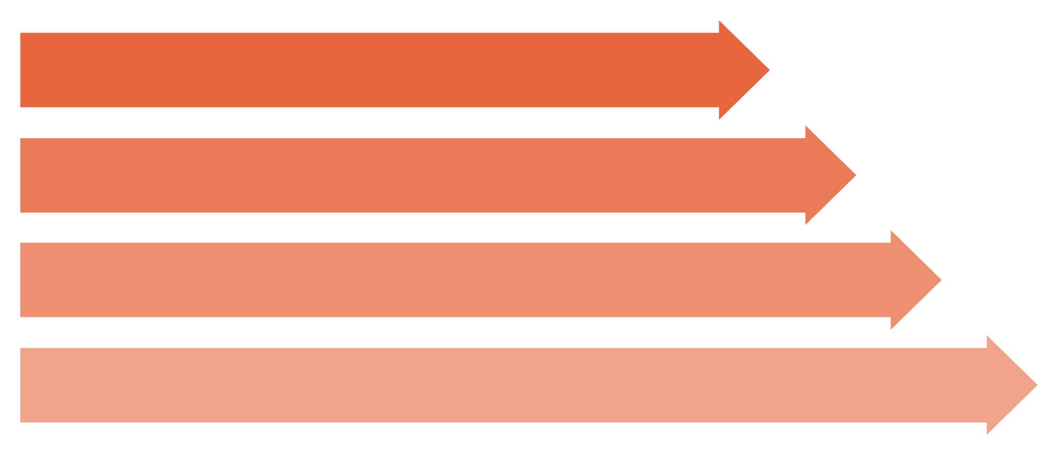
Data Preprocessing Steps
Data Loading
(all 13 columns)
Missing Value Analysis
(check Age, Albumin, ALT, AST, etc.)
Outlier Detection
(numerical columns like Age, Albumin, Cholesterol)
Feature Scaling
(all numerical columns)

Slide 6
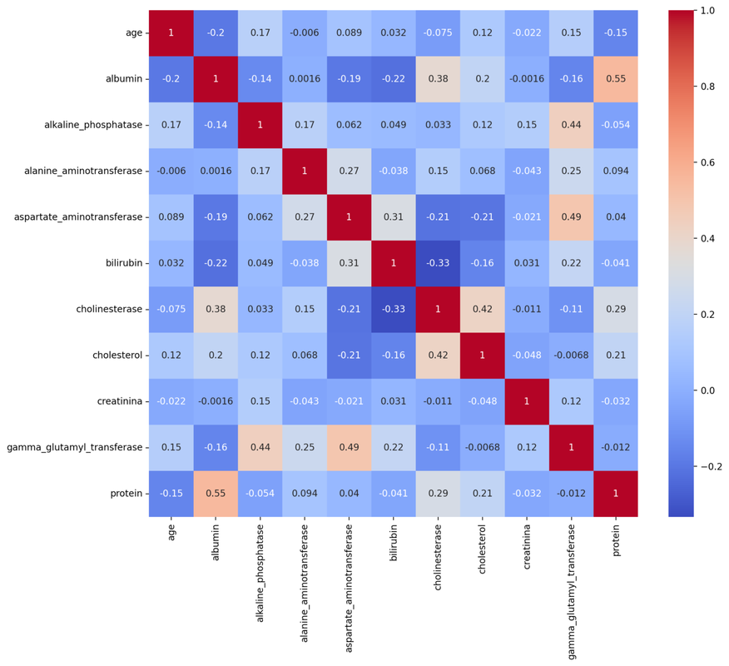
Exploratory Data Analysis (EDA)
Feature Distributions
Correlation Analysis
Target Variable Analysis
Analyze the distribution of individual features to understand their spread, skewness, and overall patterns.
Investigate relationships between all variables using correlation matrices and heatmaps to detect associations.
Visualize the distribution of the target variable to check for class imbalance and key characteristics.
Below is a correlation heatmap visualization illustrating the relationships between all variables.
Key Findings:
  Strong positive correlation observed between certain liver enzymes (e.g., ALT and AST), which is expected in liver disease indicators.
  Moderate correlations between Age and Cholesterol, suggesting a relationship between these factors in the dataset.
  The target variable shows notable correlations with several features, indicating their potential importance for prediction.

Slide 7
Model Building
The models we used are:
LightGBM (Accuracy: 0.943089): This gradient boosting framework uses tree-based learning, designed for efficiency and high accuracy, often outperforming other gradient boosting methods.
Random Forest (Accuracy: 0.934959): An ensemble learning method that builds multiple decision trees and outputs the mode of their class predictions or mean prediction.
XGBoost (Accuracy: 0.926829): An optimized and efficient distributed gradient boosting library known for solving data science problems quickly and accurately.
Logistic Regression (Accuracy: 0.926829): A statistical model that estimates the probability of a certain class or event, widely used for binary classification.
Decision Tree (Accuracy: 0.918699): A non-parametric supervised learning method that partitions data into subsets based on feature values, forming a tree-like decision structure.
KNN (K-Nearest Neighbors) (Accuracy: 0.918699): A non-parametric, instance-based learning algorithm that classifies data points based on the majority class of their 'K' nearest neighbors.
Naive Bayes (Accuracy: 0.910569): A probabilistic classifier based on Bayes' theorem, assuming independence between features, known for its simplicity and speed.
SVM (Support Vector Machine) (Accuracy: 0.910569): A supervised learning model that finds an optimal hyperplane to separate data points into different classes, maximizing the margin between them.

Slide 8
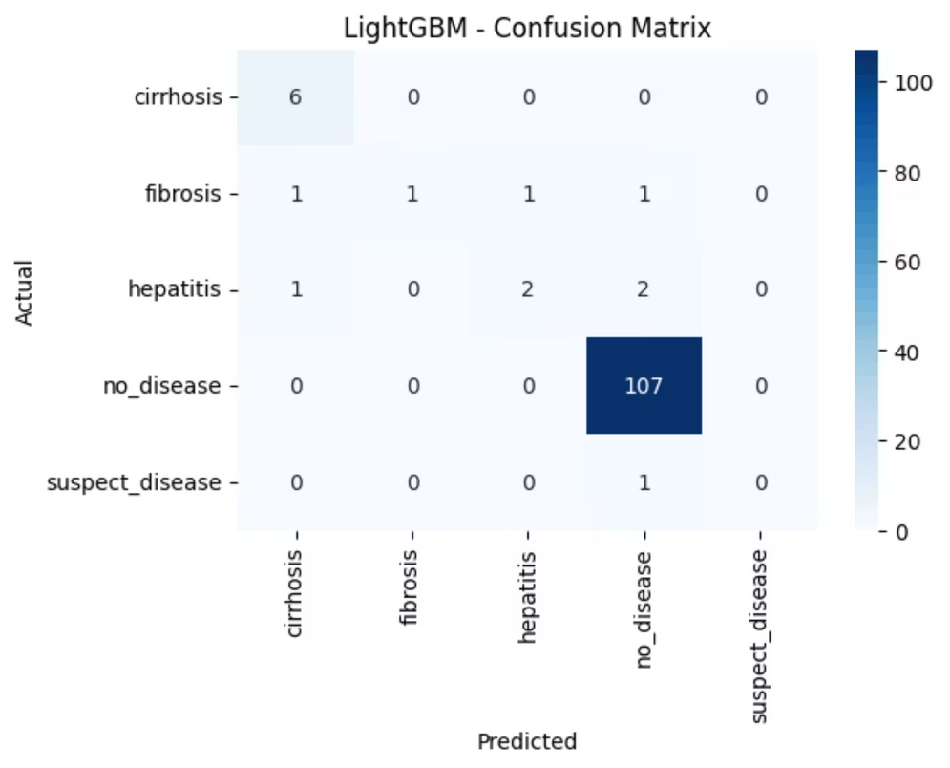
Model Evaluation
We explored various machine learning models for our task, evaluating their performance based on accuracy. Below is a summary of the models used, highlighting LightGBM as the top performer.
  LightGBM: 0.943089 Accuracy
  Random Forest: 0.934959 Accuracy
  Logistic Regression: 0.926829 Accuracy
  SVM (Support Vector Machine): 0.910569 Accuracy
This confusion matrix illustrates the performance of our best-performing LightGBM model, demonstrating how effectively it classifies each disease category based on its predictions versus the actual outcomes.

Slide 9
Deployment
Framework Used: Streamlit
Execution Command: streamlit run app.py
Deployment Steps
1.Open CMD in project folder
2.Run `streamlit run app.py`
3.App opens in browser
Deployment Flow
Project Folder → CMD → Browser → Liver Disease App
Final Outcomes
  Interactive web app
  Data overview & analysis
  Model training & evaluation
  Real-time predictions

Slide 10
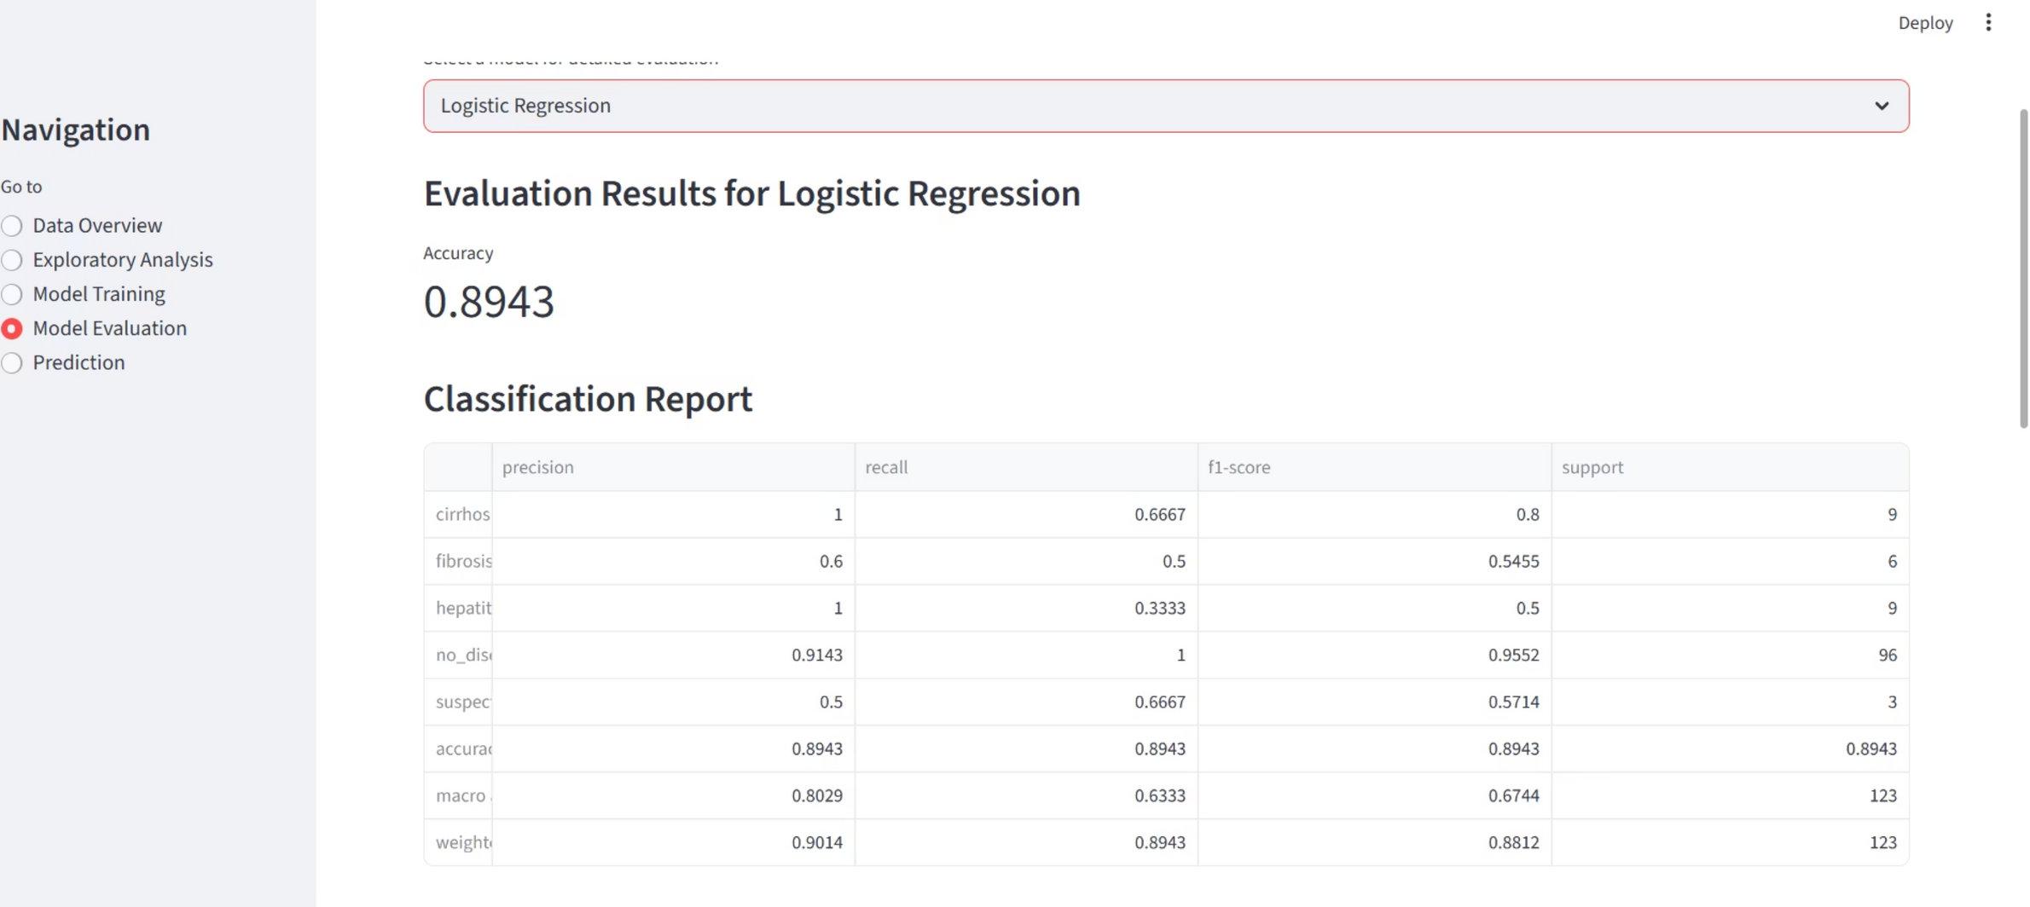
Output Screen

Slide 11
Conclusion and Future Scope
Conclusion
  Built an interactive Liver Disease Prediction App using Streamlit
  Successfully performed data preprocessing, analysis, model training, and evaluation
  Achieved reliable results with models like LGBM ,Random Forest, Logistic Regression, and SVM
  Provides real-time predictions based on patient input features
Future Scope
  Improve accuracy with advanced ML/DL models
  Deploy on cloud platforms (Streamlit Cloud, Heroku, AWS) for global access
  Integrate with real-time medical databases / hospital systems
  Add visual dashboards for doctors and healthcare professionals
  Enhance user interface with mobile-friendly designgremve that thankyou in picture give like that related

Slide 12


Thank You

